Slide 1
NPL Men’s Kit Allocations (Finals)

Slide 2
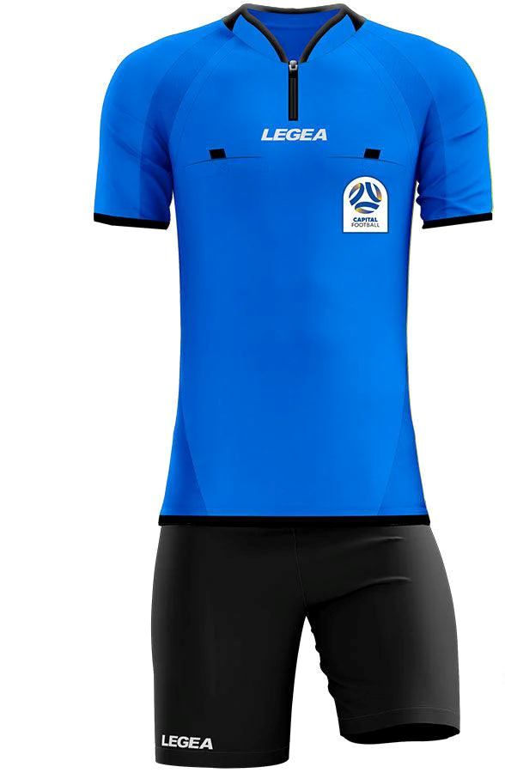
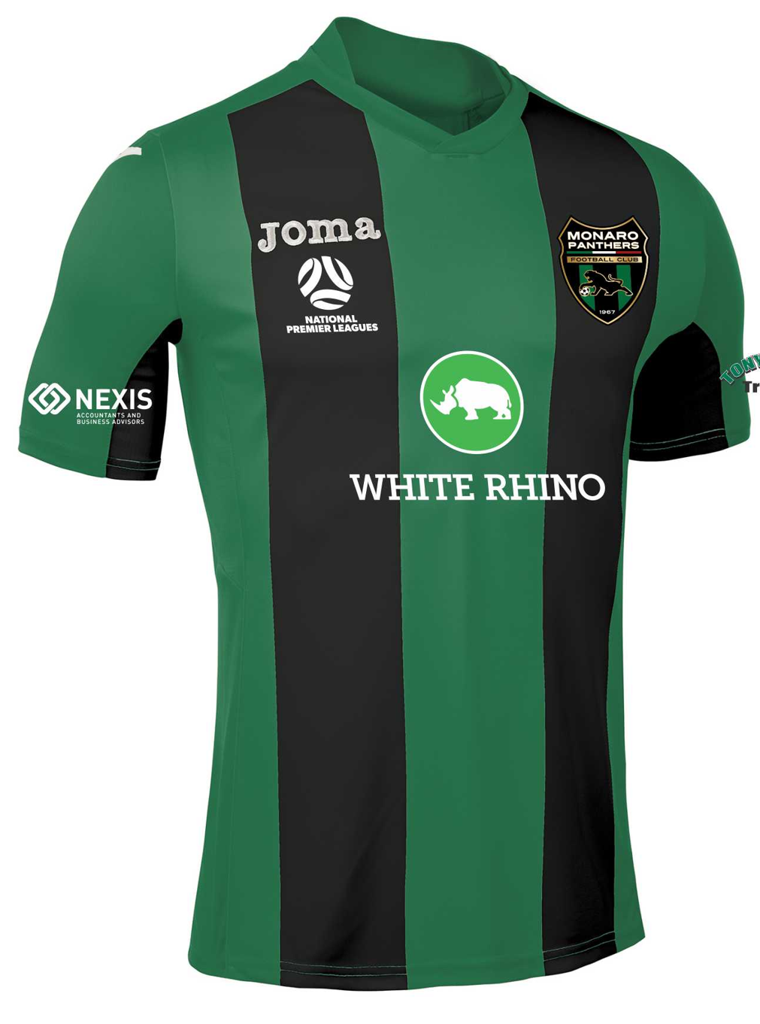
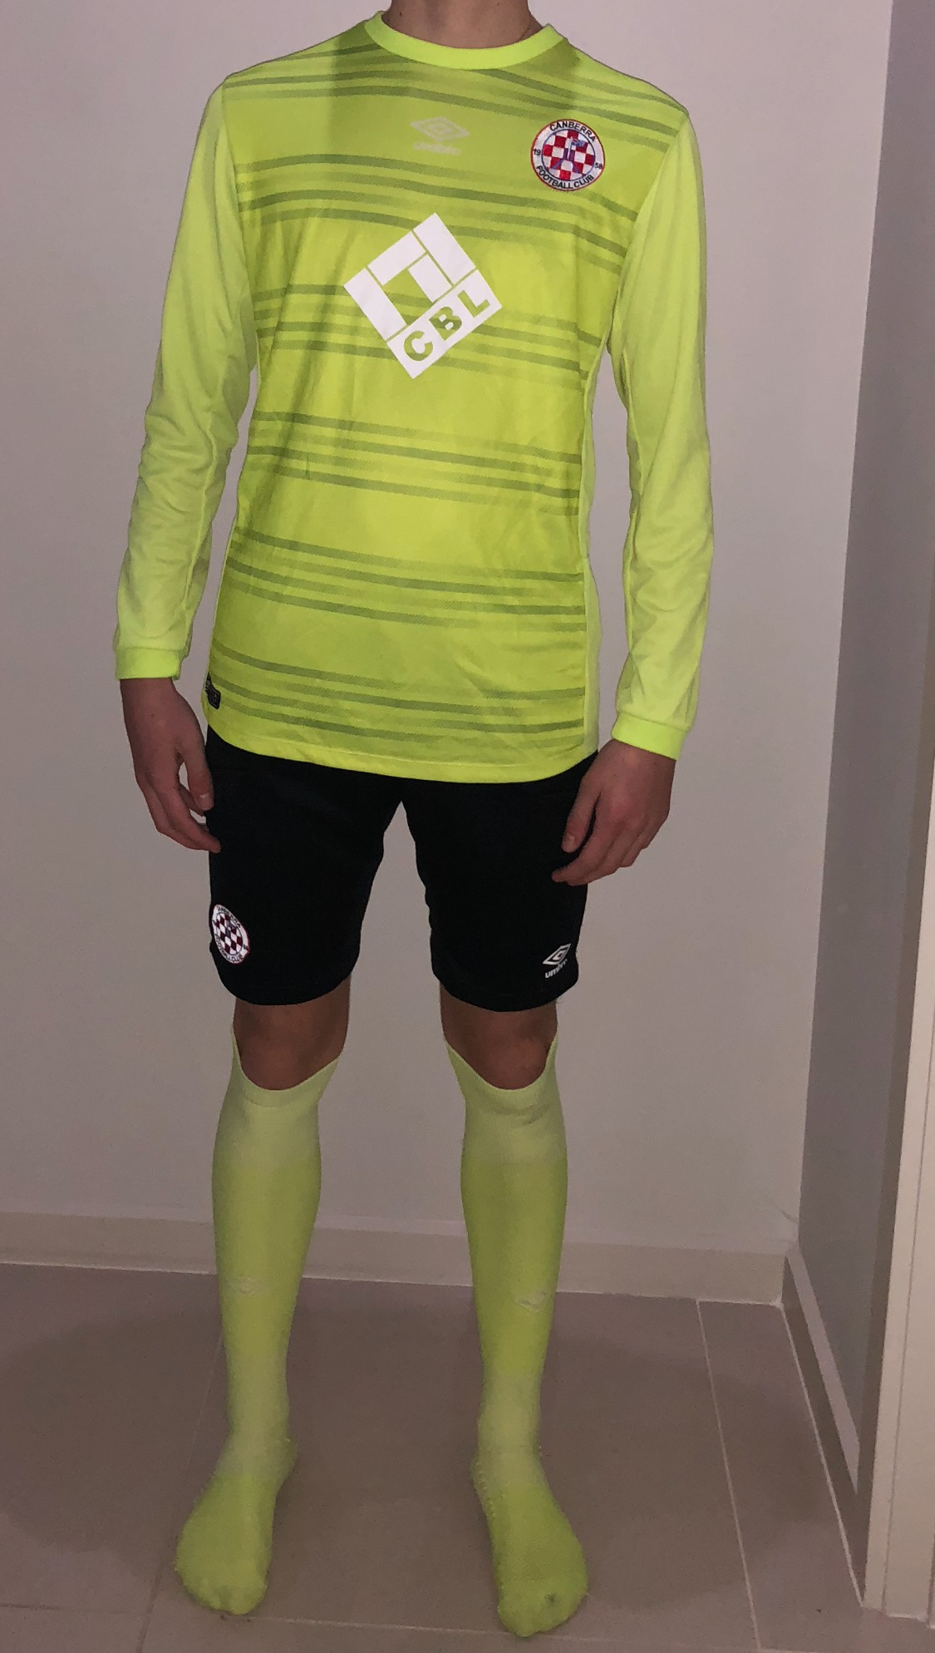
U23s - CCFC v MPFC

Slide 3
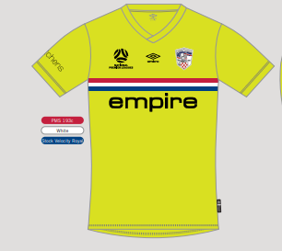
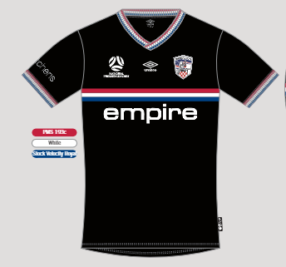
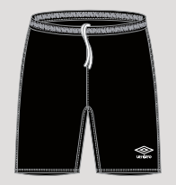
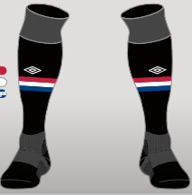
1st Grade - OCKSC v CCFC
GK Shirt – Pink
GK Shorts – Pink
GK Socks - Pink
Yellow Shorts
Yellow Socks

Slide 4
^{info@capitalfootball.com.au} ⁺⁶¹ ² ⁶²⁶⁰ ⁴⁰⁰⁰ ^{BUSINESS ADDRESS} Football House, Unit 2 / 3 Phipps Close, Deakin, ACT, 2600 ^{MAILING ADDRESS} ^{PO Box 50, Curtin, ACT, 2605}

