Slide 1
CPL Men’s Kit Allocations
(Finals)

Slide 2
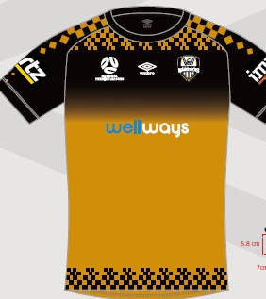
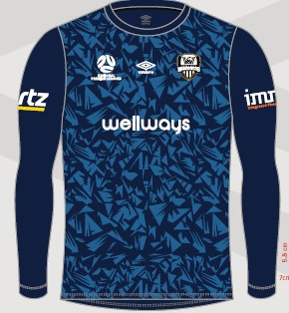
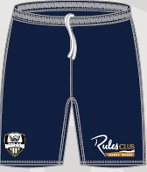
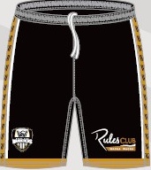
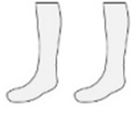
U23s – ANU Fc v WCWFc

Slide 3
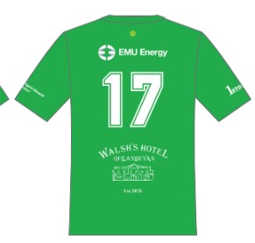
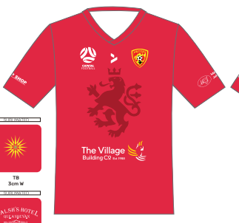
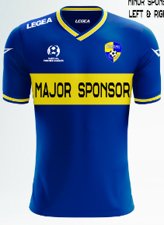
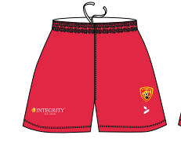
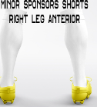
1st Grade - QCFC v YSC
GK Shirt: Black
GK Shorts: Black
GK Socks: Black
GK Shorts: Green
GK Socks: Green
Red Socks

Slide 4
^{info@capitalfootball.com.au} ⁺⁶¹ ² ⁶²⁶⁰ ⁴⁰⁰⁰ ^{BUSINESS ADDRESS} Football House, Unit 2 / 3 Phipps Close, Deakin, ACT, 2600 ^{MAILING ADDRESS} ^{PO Box 50, Curtin, ACT, 2605}

